Slide 1

DIG IT DINER
Food Delivery System

Slide 2
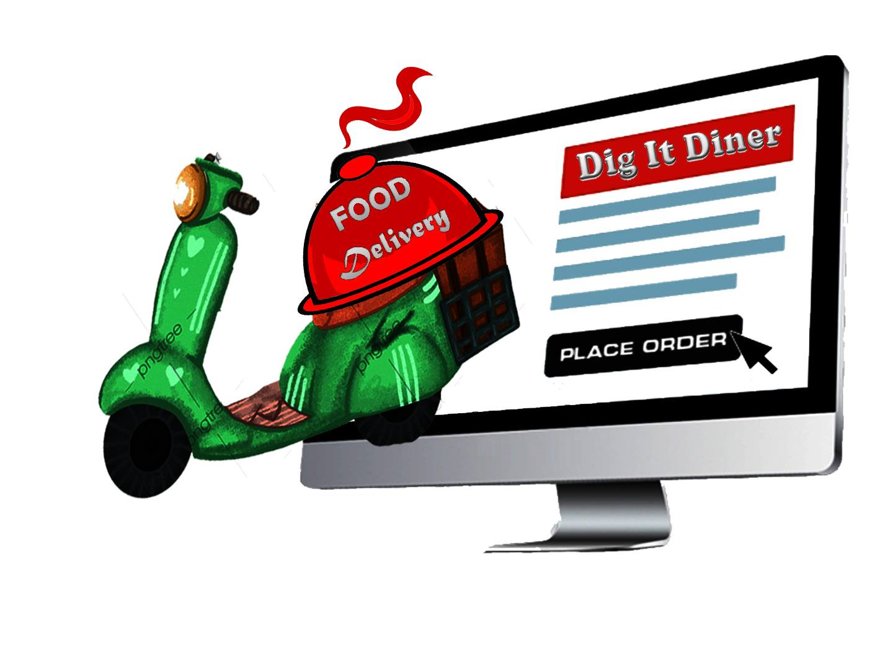
TABLE OF CONTENTS
01
02
03
04
ABSTRACT
PURPOSE
TECHNOLOGY USED
FUNCTIONALITY

Slide 3
ABSTRACT
Food delivery system is a courier service in which a restaurant or independent food ordering company delivers food to a customer. An order is typically made either through a restaurant or through a food ordering company. Customers can choose to pay online or in person, with cash or card. The delivery fee is charged with what the customer has bought.
The system, which is highly customizable, allows the restaurant employees to easily manage the system content, most importantly the menu, themselves through a very intuitive graphical interface. The purpose of this document is to provide in-depth descriptions of design and implementation details of the system, as well as descriptions of all available functionality and plans for evolution. In addition, user manuals and trouble-shooting tips have been included for all three components to give the reader a clear idea of intended typical use cases for the system.

Slide 4
PURPOSE
The purpose of this system are as follows:
Provide customers for a way to place an order at a restaurant without needing to leave the comfort of their home.
It provides following facilities to
Customer/Users
Staff/Admin

Slide 5
PURPOSE
CUSTOMER/USER
Can log in or create an account.
Can navigate the shops menu.
Can select and add an item from the shop.
Remove an item from their current order.
Place an order and provide delivery and payment details.
Can choose payment method; cash on delivery or through bank.
Receive confirmation in the form of an order number
The purpose of this system are as follows:
Provide customers for a way to place an order at a restaurant without needing to leave the comfort of their home.
It provides following facilities to
Customer/Users
Staff/Admin

Slide 6
PURPOSE
STAFF/ADMIN
Can create, update, delete shops and food menu.
Can add an employee.
Can access all the shops menu.
The purpose of this system are as follows:
Provide customers for a way to place an order at a restaurant without needing to leave the comfort of their home.
It provides following facilities to
Customer/Users
Staff/Admin

Slide 7


TECHNOLOGY USED
Language: C programming
We use File Handling to store all the data permanently even if the program terminates.

Slide 8

FUNCTIONALITY

Slide 9
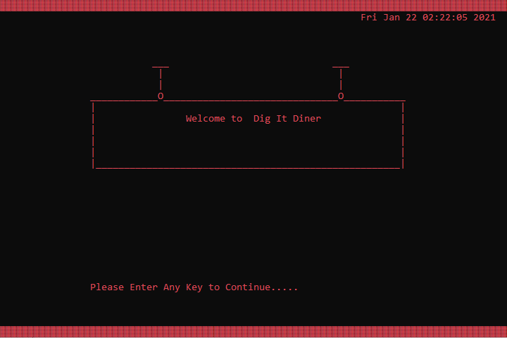
Main Interface
This is the main interface of our system where it shows the name of our food delivery. It also shows the time and date to aware the customer what time they access the system.

Slide 10
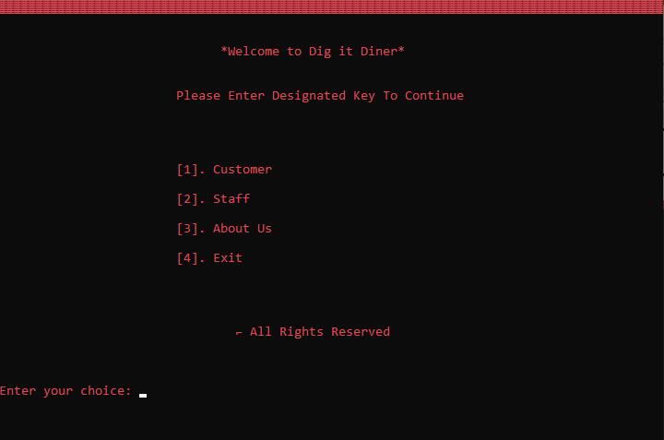
Main Menu Section
After pressing any key in the main interface. It will show the main menu section which will show the 4 category that you will choose from. First the Customer who will buy and wants to deliver food at their places. Second, Staff where admin operates and collect employee records. Third, About Us shows behind the maker of the system and last, the Exit.

Slide 11
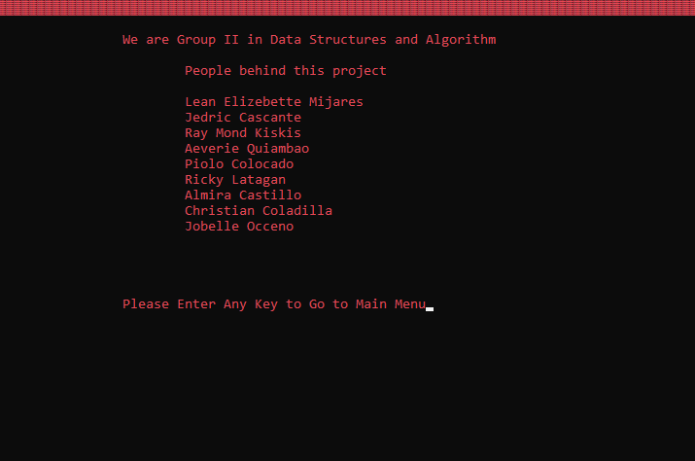
About Section
About Section indicate the leader and members who participate and make the system.
If you’re done you can back to the main menu section by pressing any kind of keys.

Slide 12
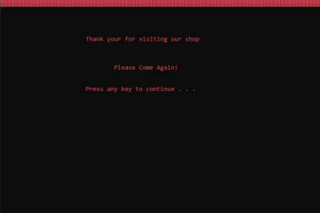
Exit Section
Exit Section closing or terminates the execution of the system.

Slide 13
STAFF SECTION
Insert Flashdrive
Admin Login
Menu Section
Restaurant Section
Food Menu
Restaurant Food menu – Add Product
Adding the Product Successfully
Restaurant Food menu – Delete Product
Delete the Product Successfully
Restaurant Food menu – Change of Price
Change Price of the Product Successfully
Restaurant Food menu – Back to Menu
Independent Food Ordering Shop
Delivery Employee
Delivery Employee – Add New Employee
Delivery Employee – Search Employee
Delivery Employee – Delete Employee
Delivery Employee – Back to Menu
Staff is the one who has broad range of administrative privileges across a system, primarily managing all the contents such as the processes and menu templates.

Slide 14
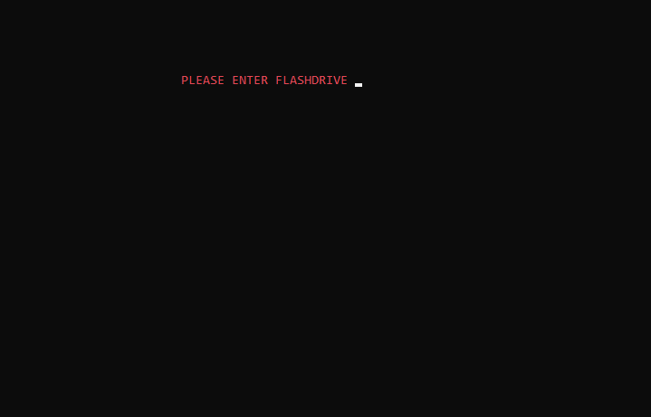
Insert Flash drive
STAFF SECTION
Flash drive must insert first to have an access to username and password in the text file before entering the staff section.

Slide 15
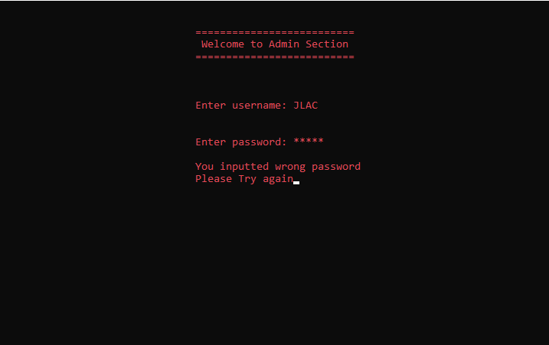
Admin Login
STAFF SECTION
If the flash drive was inserted, entering the correct username and password of the staff is a must. If the password is not valid. The program will loop again to the Admin Section so you can enter it correctly.

Slide 16
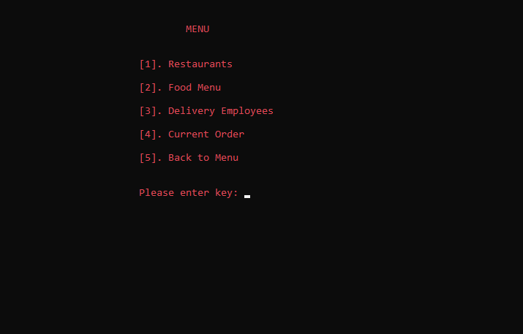
Menu Section
STAFF SECTION
The menu section will be shown after successfully logged in. The staff can choose any to the options. If they want to select the restaurants, food menu, delivery employees, the staff must enter the correct key first.

Slide 17
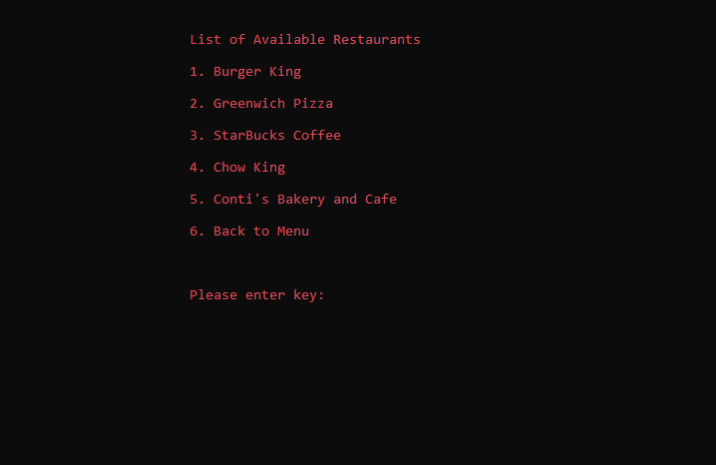
Restaurants Section
If the staff selected the restaurant menu, it will display all the available restaurants in the menu. The following available restaurants are Burger king, Greenwich Pizza, Starbuck Coffee, Chow king and Conti's Cafe and Bakery. The staff can now navigate and choose any of the available restaurants they want to add, delete or change the product.
STAFF SECTION

Slide 18
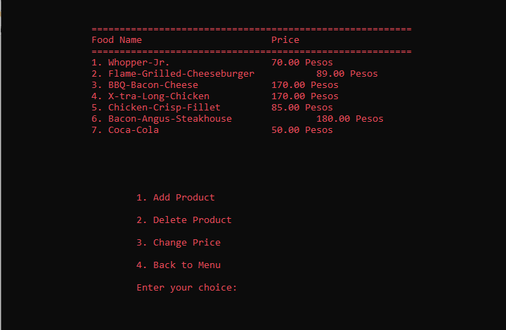
Food Menu
After choosing a certain restaurant. The staff can use the option of adding and deleting the product. The staff can also change the price of the given items from the menu. However, the staff can also go back in the restaurant’s section.
STAFF SECTION

Slide 19
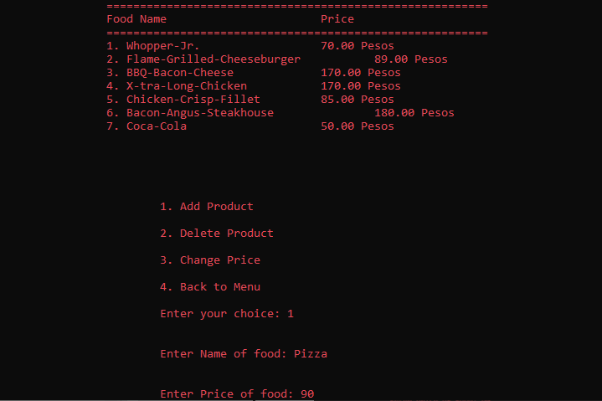
Restaurant Food Menu- Add Product
STAFF SECTION
If the staff wants to add products in the certain restaurants, Entering the name of food and the price are needed.

Slide 20
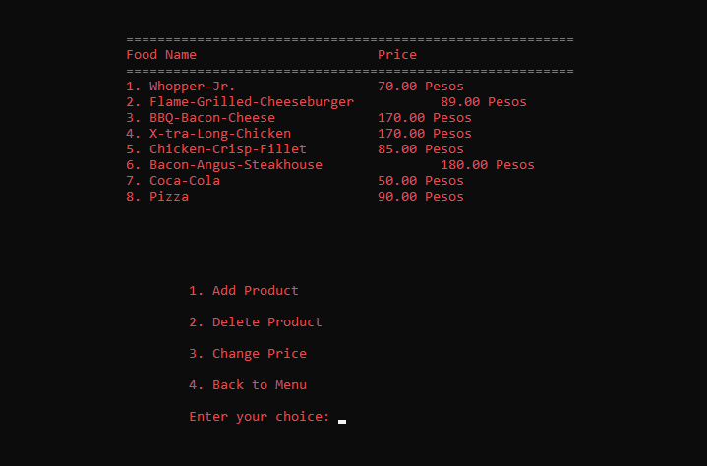
Adding the Product Successfully
STAFF SECTION
If the staff comply with the information needed, the product that was added is now prompted on the screen.

Slide 21
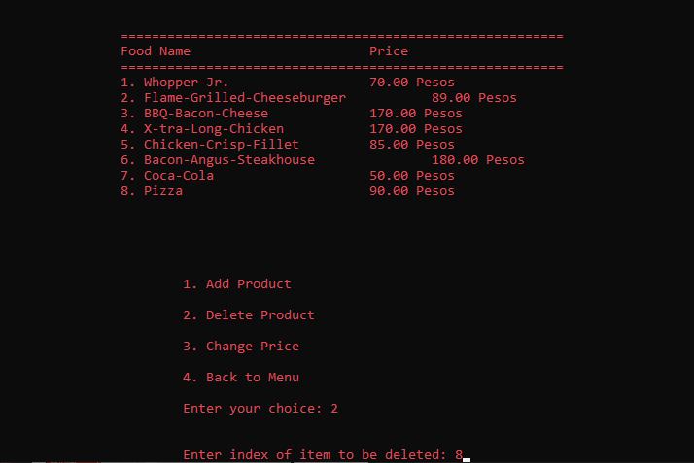
Restaurant Food menu- Delete Product
STAFF SECTION
If the staff wants to delete products in the certain restaurants, Entering the index of item is needed.

Slide 22
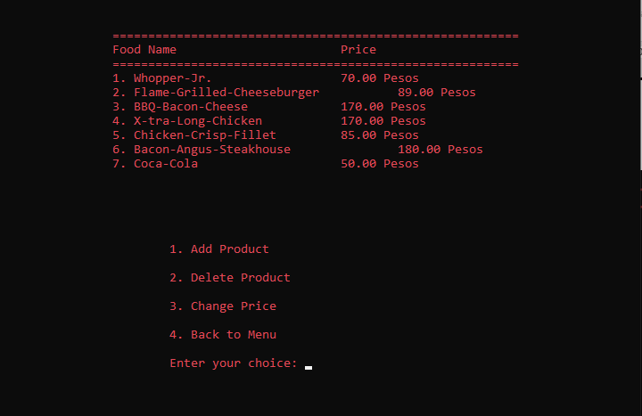
Delete the Product Successfully
STAFF SECTION
If the staff comply with the information needed, the product that was deleted is not show now to the screen.

Slide 23
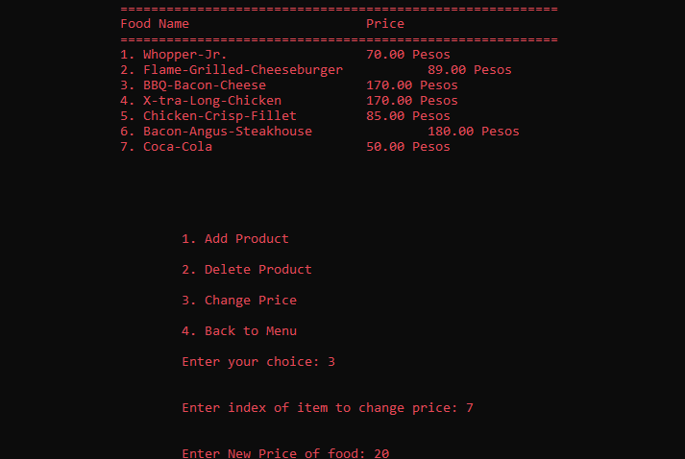
Restaurant Food menu- Change of Price
STAFF SECTION
For changing the price of a product in a chosen restaurant. the staff must input the index of the item and the new price of the item the staff wants to change.

Slide 24
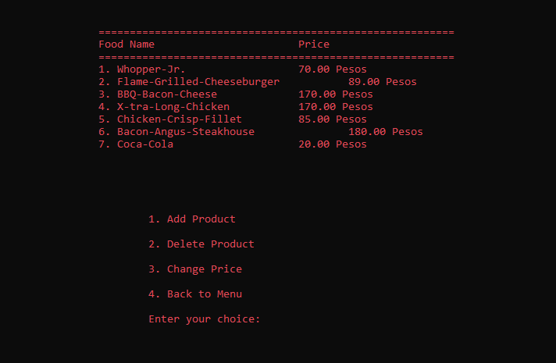
Change Price of the Product Successfully
STAFF SECTION
If the staff comply with the information needed, the price of the product is now changed and prompted on the screen.

Slide 25
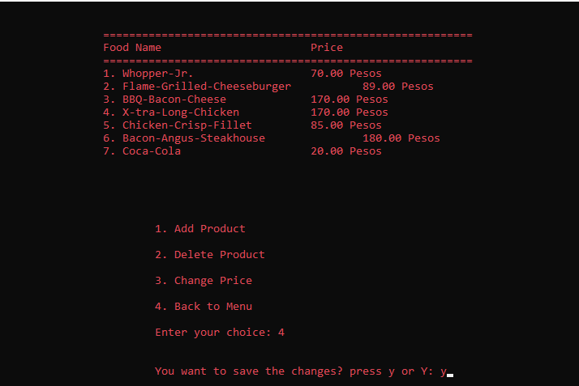
Restaurant Food menu- Back to menu
If the staff wants to go back to menu, the message “You want to save changes?” is prompted on the screen. If the staff input ‘y & Y’, all the changes that the staff did were now saved. If the staff input another key, all changes were not saved and it will loop now back to the restaurant’s menu.
STAFF SECTION

Slide 26
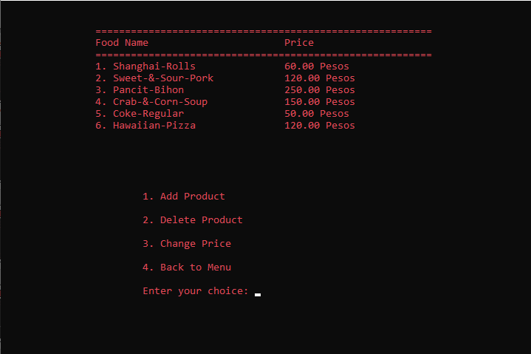
Independent Food Ordering Shop
STAFF SECTION
In our system, we also provided independent shop that also sells food products to the customer. The process of adding, deleting, and changing the price of our products were also same in restaurants menu.

Slide 27
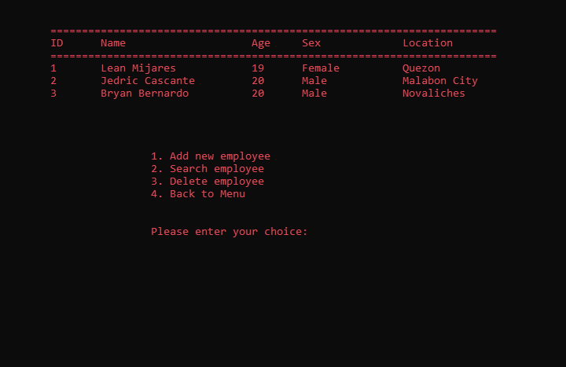
Delivery Employee
STAFF SECTION
If the staff selected the Delivery employee, the employee list are prompted on the screen. The staff can add, search, and delete existing employees.

Slide 28
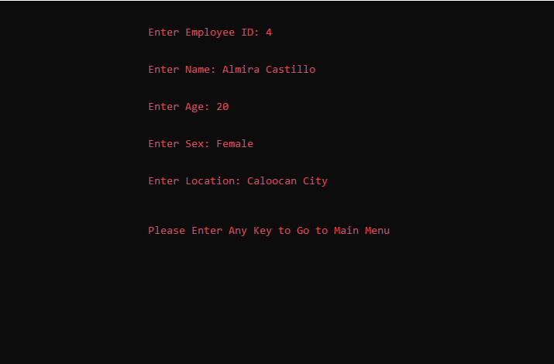
Delivery Employee- Add New Employee
To a new employee for delivery job, the staff must input the ID, name, age, gender, and location where the employee’s resided. After the staff inputted all the information of the employee, it will now save on the text file and loop in employee’s section.
STAFF SECTION

Slide 29
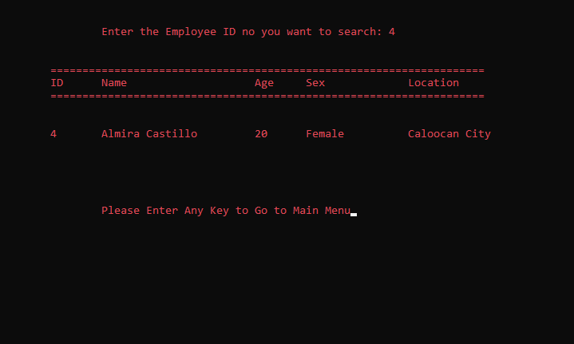
Delivery Employee- Search employee
STAFF SECTION
To search the information of certain delivery employee, the staff should input the ID number. After showing the employee information, if the staff enter the ‘enter’ key, system will now loop in employee section.

Slide 30
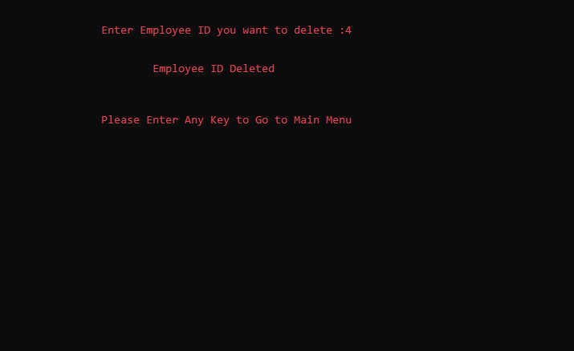
Delivery Employee- Delete employee
STAFF SECTION
To delete all the information of employee, the staff must input certain employee ID. After successfully deleted the employee, if the staff enter the ‘enter’ key, system will now loop in employee section.

Slide 31
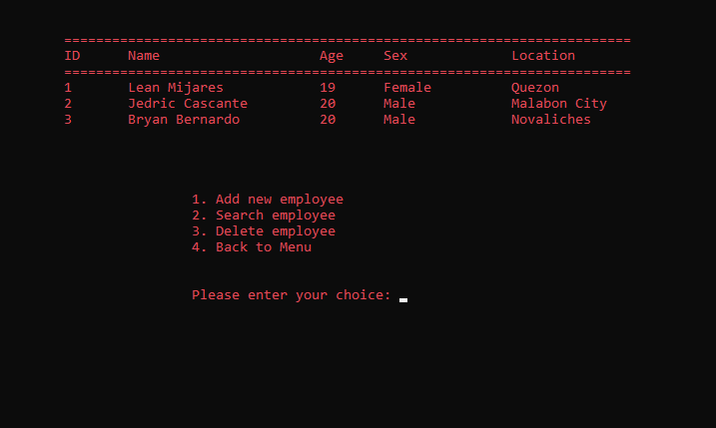
Delivery Employee- Back to menu
STAFF SECTION
If the staff enter the correct key to go back to the menu, the system will now loop to the admin section.

Slide 32
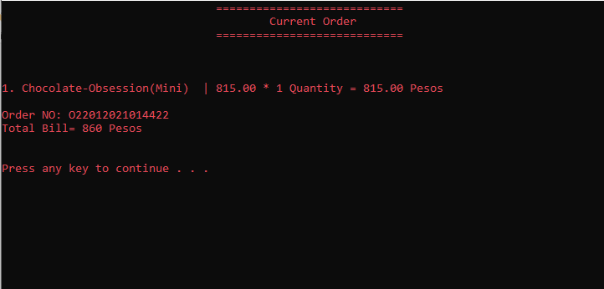
Current Order
STAFF SECTION
The staff can view the current transaction of customer’s order. After that, he can enter any key, to loop into admin section.

Slide 33
CUSTOMER SECTION
Interface
Registration
Login
Successful
Pick Restaurant
Choose Your Order
Add Order
Remove Order
Change Quantity of Order
View Order
Confirm Your Order
Cash Payment
Credit Card Payment
Customers are the ones who select which shop of food they would like to order and therefore which form should be displayed by navigating a menu bar.

Slide 34
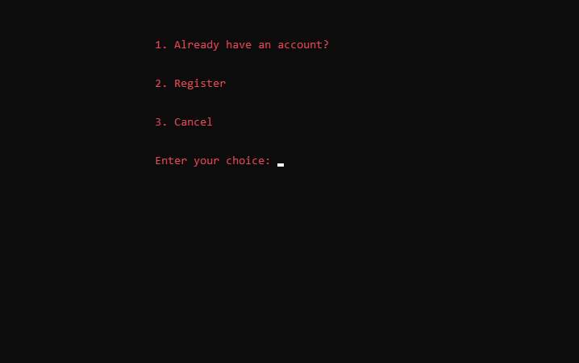
Interface
CUSTOMER SECTION
The program asks the customers for identification, if they already have an account or they want to sign up.

Slide 35
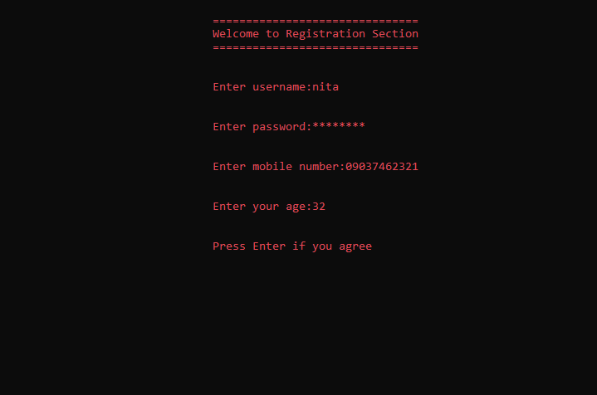
Registration
CUSTOMER SECTION
When the key register is pressed, it will ask several personal questions to ensure the person’s identity such as username, password, age and mobile number to contact then enter to back to Interface menu.

Slide 36
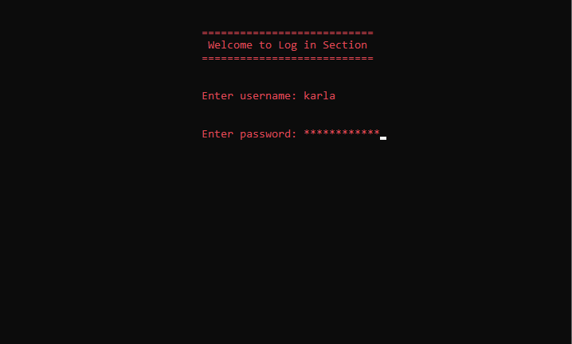
Login
CUSTOMER SECTION
When the customers want to login, they must insert their person’s identity such as username and password to access the food delivery system.

Slide 37
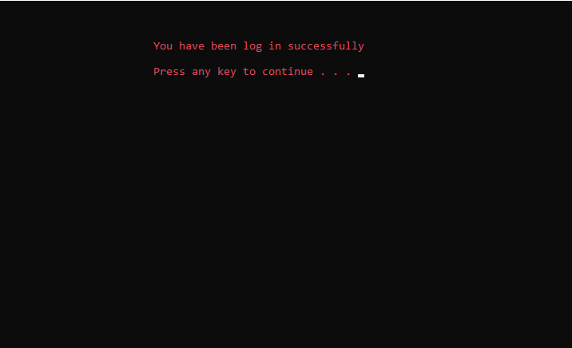
Successful
CUSTOMER SECTION
Log in successfully will prompt if the needed information is provided correctly. If not, it will loop again to Login Interface.

Slide 38
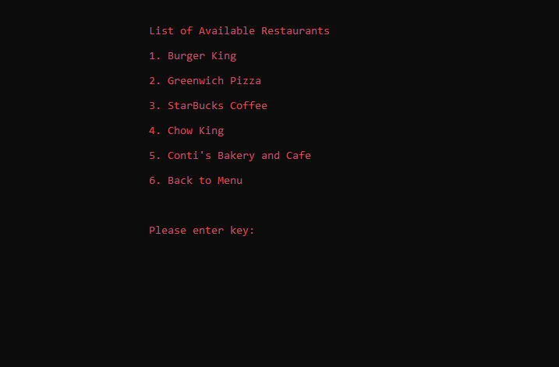
Pick Restaurant
CUSTOMER SECTION
The list of all the available restaurant are listed and after choosing the desired food, entering the corresponding key is needed

Slide 39
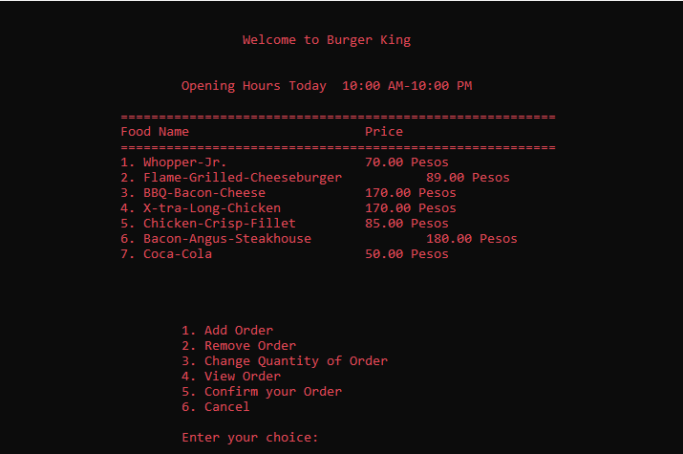
Choose Your Order
CUSTOMER SECTION
Upon clicking the right key of choice, the system will show various foods to pick. It includes the working hours, food name with their corresponding food price.

Slide 40
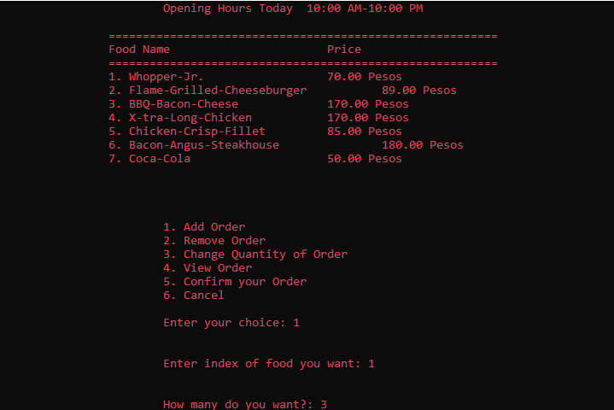
Add Order
CUSTOMER SECTION
This choice follows other questions connected to place order for the product. It asks the exact food the customer desired and the number of quantities they want to buy.

Slide 41
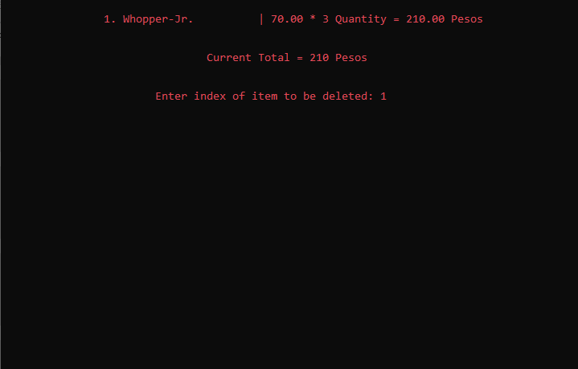
Remove Order
CUSTOMER SECTION
This choice asks the customer what index of item they want to remove. It shows the list of order they added to the cart and if they comply with the needed information it will loop again to the menu interface.

Slide 42
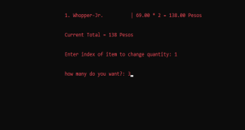
Change Quantity of Order
CUSTOMER SECTION
This choice asks the customer what index of item they want to change the quantity. It shows the list of order they added to the cart and if they comply with the needed information it will loop again to the menu interface.

Slide 43
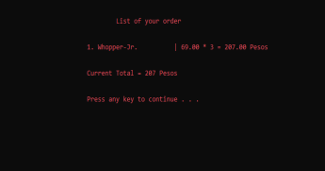
View Order
CUSTOMER SECTION
It will show the updated list of the customer’s order and the total amount they just placed. If you enter any key it will loop again to the menu interface.

Slide 44
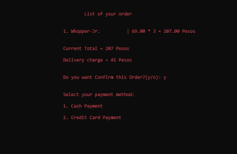
Confirm Your Order
CUSTOMER SECTION
The list of customer’s orders is listed on the screen, if they confirm their order, they have a choice what payment method they choose.

Slide 45
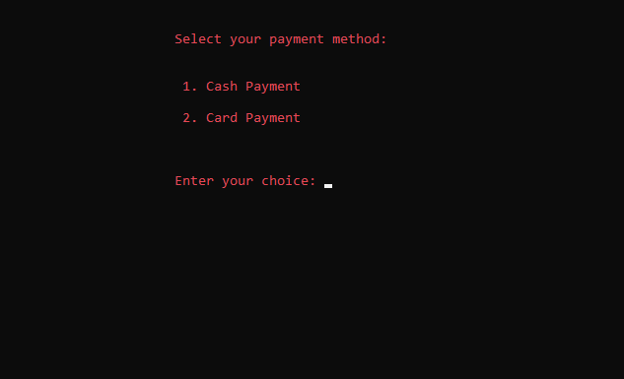
Payment Method
CUSTOMER SECTION
Customer can now choose what payment method they will use; Cash Payment or Card Payment.

Slide 46
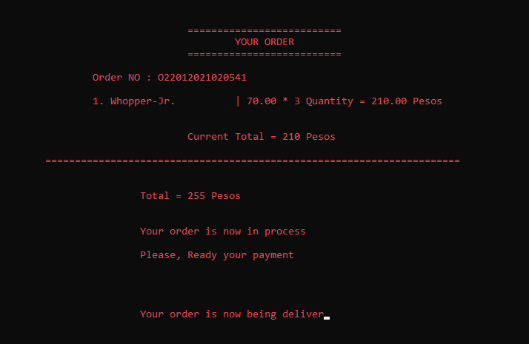
Cash Payment
CUSTOMER SECTION
If the customers choose the Cash Payment, the order list is printed on the screen. The delivery charge is automatically inserted in their total payment, all they need is wait for their order.

Slide 47
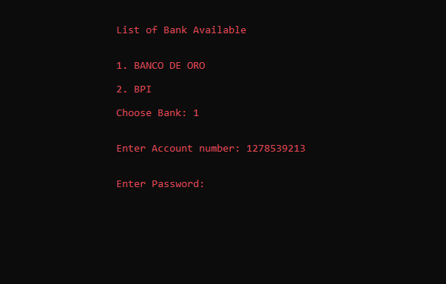
Credit Card Payment
CUSTOMER SECTION
If the customers choose the Credit Card Payment, the account number and password that is available in the system must be inserted. The delivery charge is automatically inserted in their total payment, all they need is wait for their order.

Slide 48
FOOD DELIVERY SYSTEM
By:
Cascante, Jedric
Castillo, Almira Louise
Colocado, Piolo
Coladilla, Christian
Kiskis, Ray Mond
Latagan, Ricky Mark
Mijares, Lean Elizebette
Occeno, Jobelle
Quiambao, Meinard Aeverie

Slide 49
-END-

